Slide 1
Principal: principal amount or sum is the money borrowed or lent out for a certain period.
Interest: Interest is the extra amount paid on principal amount with a year marked percent.
Interest can be of two types
1. Simple Interest 2.Compound interest
When the interest is payable on the principal only, it is called Simple interest.
Where as in Compound interest the interest for each period is added to the principal before interest is calculated for the next period

Slide 2
Simple Interest

Slide 3
Question
A man took a loan from a bank at the rate of 12% p.a. simple interest. After 3 years, he had to pay Rs. 5400 as interest for the period. What was the principal amount borrowed by him?

Slide 4
Question
How much time will it take for an amount of Rs. 450 to yield Rs. 81 as interest at the rate of 4.5% p.a. simple interest?

Slide 5
Question
An amount of Rs. 2400 is due after 6 years under simple interest at 10% p.a. Find its present value.

Slide 6
Find the simple interest on Rs. 6000 at 7 % per annum for the period from 15th Feb to 29th April, 2017.
A. Rs.75 B. Rs.54 C. Rs. 60 D. Rs.84

Slide 7
The rate of interest on a sum of money is 4% per annum for the first 2 years, 6% per annum for the next 4 years and 8% per annum for the period beyond 6 years. If the simple interest accrued by the sum for the total period of 9 years is Rs 1680. What is the sum?
A. Rs.3000 B. Rs.2900 C. Rs.2600 D. Rs.2500

Slide 8
Question
A sum of Rs.1550 is lent out in two parts one at 8% and another one at 6%. If the total annual income is Rs.106, the money lent at 8% is:
A. Rs.800 B. Rs. 900 C. Rs. 1000 D. Rs. 650

Slide 9
Compound Interest

Slide 10
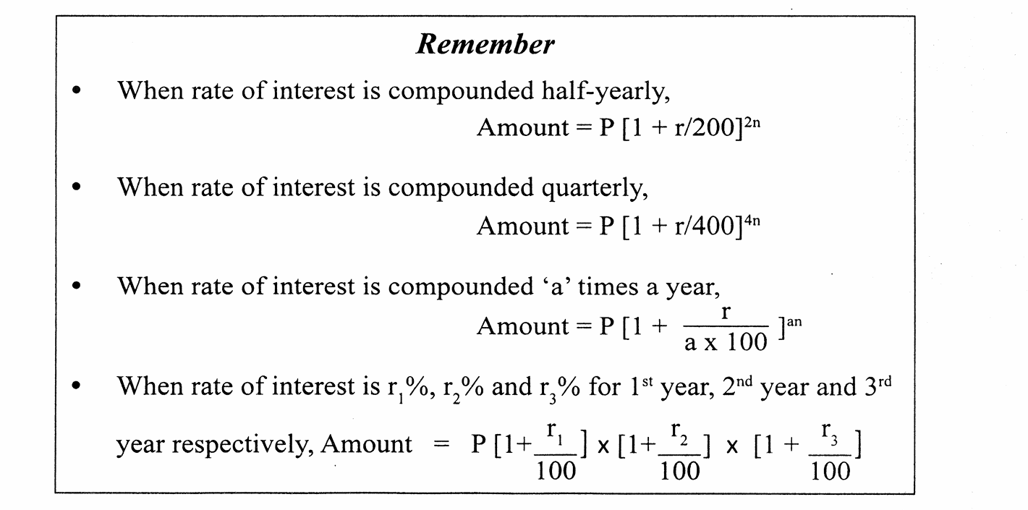

Slide 11
Question
The compound interest on Rs. 30000 at 7% p.a. is Rs. 4347. The period (in years) is __________

Slide 12
Question
At what rate of interest p.a. under C.I. will a sum of Rs. 1200 become Rs. 1348.32 in 2 years?

Slide 13
Question
A man invests Rs. 10000 in an account that pays 8% interest per year, compounded quarterly. What is the amount of money that he will have after 1.5 years?

Slide 14
Question
An amount of money grows up to rs. 7200 in 2 years and upto Rs.8100 in 3years on compound interest. Find the ratio of interest percent?
A)10.25%
12.5%
11%
9.75%
13%

Slide 15
Relation Between Simple and Compound Interests

Slide 16
Question
If a sum of money doubles itself in 5 years, in how many years does it becomes 8 times the original?
Using Simple Interest , the money becomes 8 times in__________
ii. Using Compound Interest, the money becomes 8 times in __________

Slide 17
Question
If the simple interest on a sum of money for 2 years at 5% p.a. is Rs. 50, what is the compound interest on the same amount at the same rate of interest and for the same time?

Slide 18
Question
Given the difference between SI and CI for 2 years on the same sum and at the same rate of interest, compounded annually is Rs. 120. The difference between SI and CI for 3 years on the same sum and at the same rate of interest is Rs. 366. Find the rate of interest.

Slide 19
Concept Review Questions

Slide 20
Question
If 45 is 120% of a number, then what is 80% of the same number?
A)
30
B)
32
C)
36
D)
38

Slide 21
Question
The population of a town was 3600 three years back. It is 4800 right now. What will be the population three years down the line, if the rate of growth of population is constant over the years?
A)
6400
B)
6000
C)
5800
D)
6600

Slide 22
Question
Two students appeared for an examination. One of them secured 9 marks more than the other and his score was 56% of the sum of their marks. The marks obtained by them are:
A)
39, 30
B)
43, 32
C)
42, 33
D)
43, 34

Slide 23
Question
Peter got 30% of the maximum marks in an examination and failed by 10 marks. However, Paul, who took the same examination, got 40% of the total marks and got 15 marks more than the pass mark. What was the pass mark in the examination?
A)
75
B)
250
C)
90
D)
85

Slide 24
Question
A shepherd has 1 million sheep at the beginning of the year 2000. The numbers grow by x%, (x > 0) during the year. A famine hits his village in the next year and many of his sheep die. The sheep population decreases by y% during 2001 and at the beginning of 2002 the shepherd finds that he is left with 1 million sheep. Which of the following is correct?
A)
y > x
B)
x = y
C)
x > y
D)
xy = 0

Slide 25
Question
If the price of petrol increases by 25% and Kevin intends to spend only an additional 15% on petrol, then by what percentage must he reduce the quantity of petrol purchased?
A)
6.67%
B)
10%
C)
8%
D)
None of these

Slide 26
Question
A vendor sells 60% of apples he had and throws away 15% of the remaining apples. Next day, he sells 50% of the remaining apples and throws away the rest. What % of the apples does the vendor throw away?
A)
23
B)
17
C)
77
D)
29

Slide 27
Question
In how many years will a sum double itself at 12.5% p.a. simple interest?
A)
4
B)
8
C)
10
D)
16

Slide 28
Question
Divide Rs. 3000 into two parts such that, the simple interest on the first part for 4 years at 8% per annum is equal to the simple interest on the second part for 2 years at 9% per annum.
A)
1000, 2000
B)
1280, 1720
C)
1160, 1840
D)
1080, 1920

Slide 29
Question
Meena deposited a sum of Rs. 8000 in a bank paying simple interest. After one year, she withdraws Rs. 2000. At the end of 3 years, she received Rs. 7800. Find the rate of interest, assuming that she never collected her interests till then.
A)
9%
B)
8%
C)
10%
D)
12%

Slide 30
Question
A man invests Rs. 5000 for three years at a certain rate of interest, compounded annually. At the end of one year it amounts to Rs. 5600. Calculate the amount due at the end of the second year.
A)
Rs. 6200
B)
Rs. 6272
C)
Rs. 6260
D)
Rs. 6320

Slide 31
Question
Find the amount due on Rs. 8000 in 2 years if the rate of interest is 10% for the first year and 12% for the second year.
A)
Rs. 9716
B)
Rs. 9856
C)
Rs. 10156
D)
Rs. 9756

Slide 32
Question
Find the difference between S.I. and C.I. on Rs. 2500 for 2 years at 4% p.a., compound interest, interest being compounded semi-annually.
A)
Rs. 4.00
B)
Rs. 6.08
C)
Rs. 4.68
D)
Rs. 5.88

Slide 33
Question
A man invests Rs. 6500 for 3 years at 4.5% p.a. compound interest, compounded annually. 20% is deducted at the end of each year from this investment for expenditures. Find the amount due at the end of the third year.
A)
Rs. 3688.24
B)
Rs. 4946.62
C)
Rs. 3797.80
D)
Rs. 5244.04

Slide 34
Question
A sum of Rs. 550 was taken as a loan. This is to be paid back in two equal installments. If the rate of interest is 20% p.a. compound interest, being compounded annually, then the value of each installment is:
A)
Rs. 421
B)
Rs. 300
C)
Rs. 360
D)
Rs. 350

